Slide 1
Effective Identification and Engagement of Transportation Stakeholders Using Geospatial Analytics and Online Advertising
Okan Pala, Ph.D. | opala@ncsu.edu
George Orfanidis | orfanidisg2@winthrop.edu
Joseph E. Hummer | Chair
Jamille Robbins | Member
Anna Henderson | Member
Sean Epperson | Member
Terry Canales | Member
Mike Reese | Member
North Carolina State University

Slide 2
NCDOT Research & Innovation Summit 2020
Transportation Planning Process
Choice of site
Ranking transportation needs
Public input
Problem Statement
Local stakeholders are more likely to get involved in the planning process of it compared to commuting stakeholders
Some stakeholders participate in the planning of the project because they are skeptical about long term construction nearby.
Some stakeholders do not live in the vicinity of the project location and therefore they are
Not aware of the existence of the project
Not aware of the improvement that the project implementation would provide to them
Local: stakeholders that live or work in close proximity to the project’s location
Commuting: stakeholders that regularly commute near the project’s location
Notes:
As a part of the project development phase, the public outreach and engagement stage is one of the most important parts of transportation project planning. At this stage, the public is informed about the future plans, the benefits for the broader community are explained and direct and indirect feedback is gathered. Organizing and implementing public hearings, while effective, falls short on involving all stakeholder groups who would be affected by the implemented project. One of the reasons for that is the difficulty in identifying and engaging certain transportation project stakeholders.
Data from previous outreach and engagement campaigns has revealed some public representation flaws. Local stakeholders are more likely to attend public hearings compared to those who are commuting stakeholders. This creates a one-sided perspective that may not reveal the actual value (or lack thereof) of the proposed transportation project.
Additionally, participation data has revealed that many people get involved in the planning process to push back the actualization of a project simply because they do not want constructions near their location. Evidently, it is important to identify stakeholders that have honest interest in the outcome of the project.
The overall purpose and effort of identifying stakeholders and appropriately targeting them is to have an equal, fair, and full representation of people involved with and making decisions for a given transportation project.

Slide 3

NCDOT Research & Innovation Summit 2020
Overarching Goal
NCDOT aims to gain the input from full spectrum of citizens
Involving the public early
Continued involvement

Slide 4
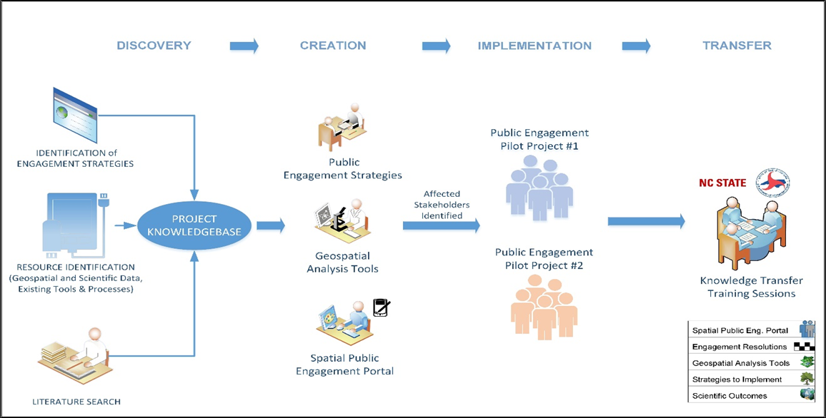
NCDOT Research & Innovation Summit 2020
Overview of the project
Notes:
Discovery Phase Objective: Review existing internal and external resources for data, tools, and literature as well as public involvement procedures.
Creation Phase Objective: Provide NCDOT with geospatial analysis tools, targeted public engagement strategies, and an interactive spatial public engagement portal to increase effectiveness of outreach activities with stakeholders with variety of views.
Implementation Phase Objective: Implement tools, strategies and engagement portal created in previous phase for pilot projects and investigate their effectiveness.
Transfer Phase Objective: Integrate geospatial analysis tools and public engagement strategies into existing workflows through training. If not possible, recommend new workflows.

Slide 5
NCDOT Research & Innovation Summit 2020
Notes:
he answer to this question is rooted in location and demographic analysis.
Here is an overview of the public outreach and engagement method we developed to efficiently identify and target affected transportation stakeholders
Multiple online advertising campaigns will be created by an automation tool called RPA. Demographic concentration analysis in conjunction with spatial analysis will be used to determine the areas of interest. Finally, targeted stakeholders will be directed to a personalized portal that will inform them about the proposed project. They will also be able to express their opinion by submitting a form.

Slide 6
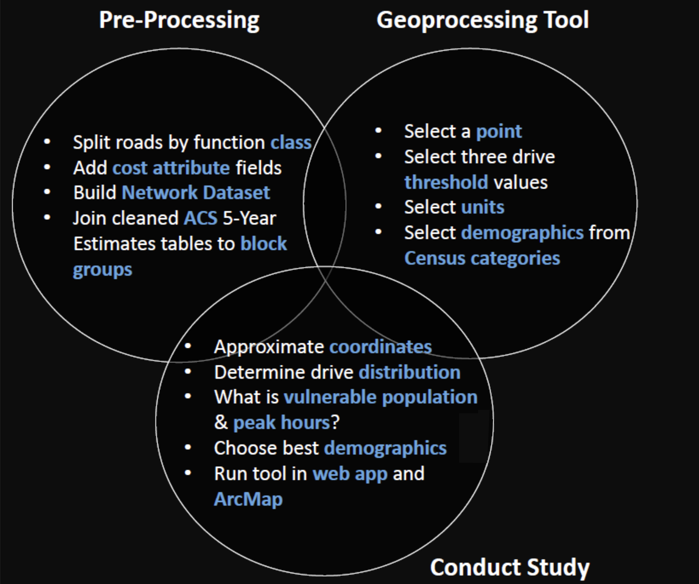
NCDOT Research & Innovation Summit 2020
Geospatial Analysis Tools
Network Analysis | Affected Areas | Areas with Demographic Interest
Notes:
Our tool will use Network analysis and driving polygons with demographic data that has been previously created (Pala, Xena, 2019). We aim to utilize those driving polygons to determine the locations of interest by further spatial and demographic analysis.
Drive-time polygons basically depict how far someone can reach in a specified amount of time if he or she is driving under the speed limits.
The initial phase was to collect relevant data to conduct network analysis. Road data was collected from different categories to form the transportation network. Moreover, demographic data from the American Community Survey (ACS) was incorporated to estimate the population of a specific demographic category within the borders of the driving polygon. Finally, the project’s location was used as the center of the driving polygons (Figure 1).

Slide 7
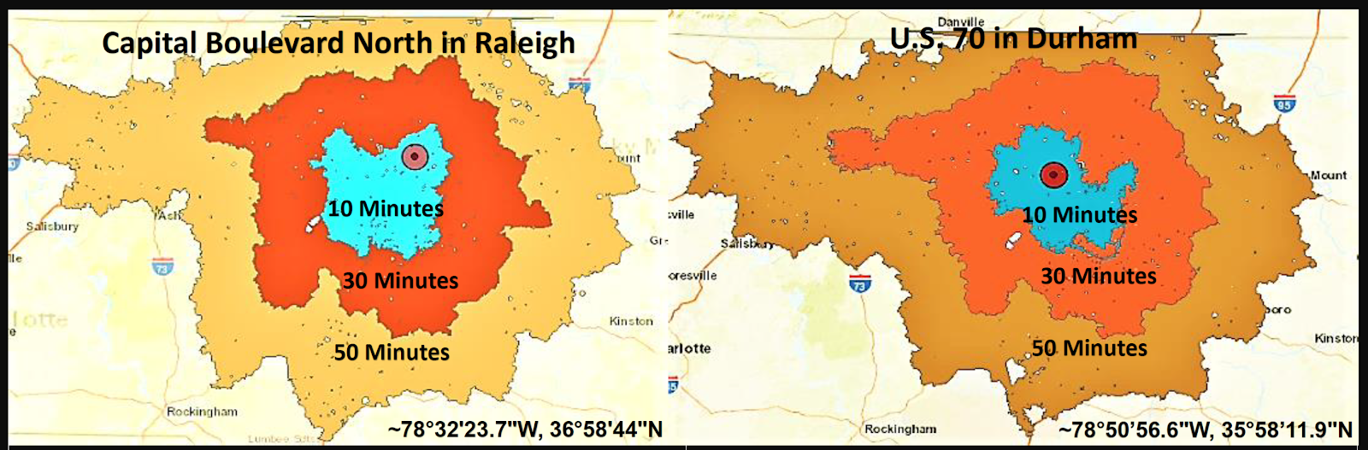
NCDOT Research & Innovation Summit 2020
Geospatial Analysis Tools
Network Analysis | Affected Areas | Areas with Demographic Interest
Notes:
Our tool will use Network analysis and driving polygons with demographic data that has been previously created (Pala, Xena, 2019). We aim to utilize those driving polygons to determine the locations of interest by further spatial and demographic analysis.
Drive-time polygons basically depict how far someone can reach in a specified amount of time if he or she is driving under the speed limits.
The initial phase was to collect relevant data to conduct network analysis. Road data was collected from different categories to form the transportation network. Moreover, demographic data from the American Community Survey (ACS) was incorporated to estimate the population of a specific demographic category within the borders of the driving polygon. Finally, the project’s location was used as the center of the driving polygons (Figure 1).

Slide 8
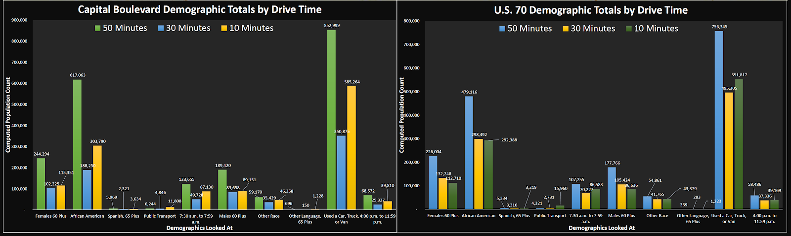
NCDOT Research & Innovation Summit 2020
Geospatial Analysis Tools
Network Analysis | Affected Areas | Areas with Demographic Interest
Notes:
Our tool will use Network analysis and driving polygons with demographic data that has been previously created (Pala, Xena, 2019). We aim to utilize those driving polygons to determine the locations of interest by further spatial and demographic analysis.
Drive-time polygons basically depict how far someone can reach in a specified amount of time if he or she is driving under the speed limits.
The initial phase was to collect relevant data to conduct network analysis. Road data was collected from different categories to form the transportation network. Moreover, demographic data from the American Community Survey (ACS) was incorporated to estimate the population of a specific demographic category within the borders of the driving polygon. Finally, the project’s location was used as the center of the driving polygons (Figure 1).

Slide 9
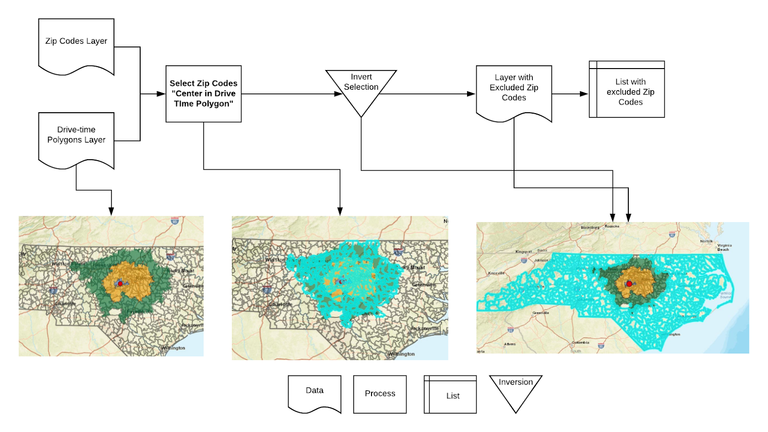
NCDOT Research & Innovation Summit 2020
Geospatial Analysis Tools
Network Analysis | Affected Areas | Areas with Demographic Interest
Notes:
The drive-time polygons will be used to identify the regions of interest for a specified transportation project. The outer drive-time polygon will determine the last area for targeting. Everything outside of that border will be considered irrelevant for targeting and as a result, will be excluded. We assume that people outside that region won’t be affected since they are far away from the project’s site (more than an hour away).
The most effective way to map the drive-time polygons as accurately as possible is by the use of Zip Codes. Our location script, firstly identifies what Zipcodes have their center in the driving polygon.. Then,the rest of North Carolina Zip Codes that are not within the boundaries of the polygon are marked for exclusion. Because Zip Codes spread out across multiple counties it was not viable to exclude broader geographic groups after we have identified the zip codes that map the drive-time polygons. Finally, all the other states and countries will be excluded to give us the final area of interest.

Slide 10
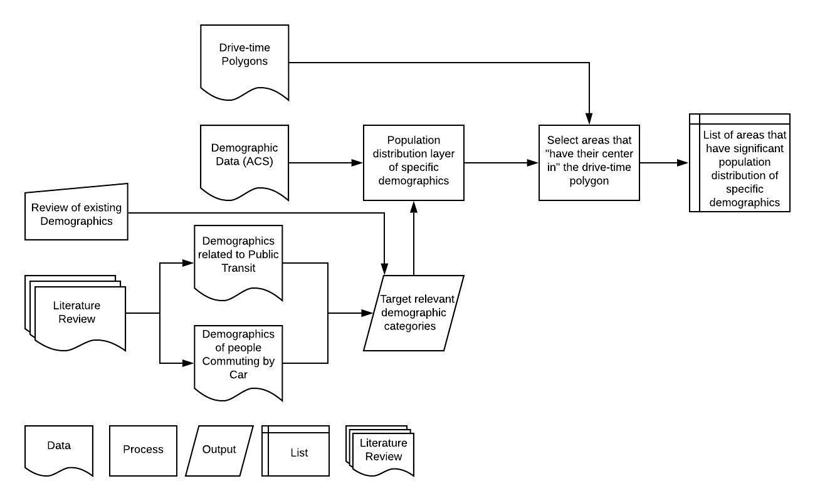
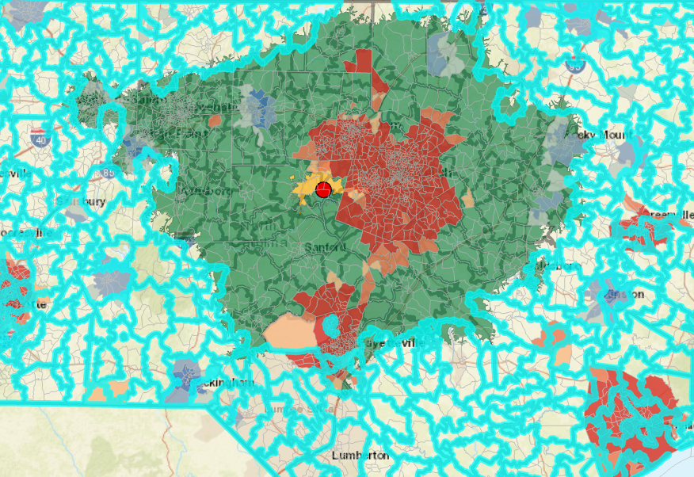
NCDOT Research & Innovation Summit 2020
Geospatial Analysis Tools
Network Analysis | Affected Areas | Areas with Demographic Interest
Notes:
With regard to targeting based on demographics, after a thorough literature review we have created demographic profiles based on people who are more relevant or have a greater interest in specific transportation projects. For example, consider people who regularly use public transportation to go to work, their feedback on a new public transportation project may be more applicable.The two categories that have been studied are public transit and commuting by car. The first category can be used to target people that are relevant to a public transportation project while the second category covers transportation projects that mainly affect stakeholders that use automobiles for commuting.
Overlaying the drive-time polygons with specific demographic data from the American Community Survey we constructed a hotspot layer that includes areas that have high concentration of stakeholders with the specific demographic characteristics we have identified and are within the outer drive time border.

Slide 11


NCDOT Research & Innovation Summit 2020

Slide 12
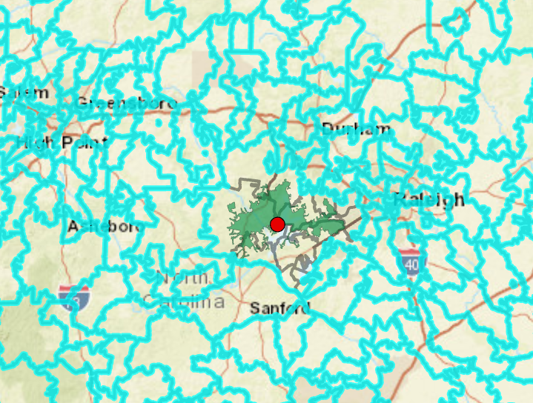

NCDOT Research & Innovation Summit 2020
Public Engagement Using Online Advertising
Target Local Stakeholders | Target Relevant but Nonlocal Stakeholders | Target Stakeholders with Relevant Demographic Profile
We aim to target stakeholders whose house/business is located in close proximity to the project’s site and as a result, they will be centrally affected by the implementation of the proposed project.
Notes:
Goal 1: Target local stakeholders
We aim to target stakeholders whose house is located in close proximity to the project’s site and as a result, they will be centrally affected by the implementation of the proposed project. The shortest drive-time polygon will be imported in our exclusion method and in relation to the Google Ads targeting option “People in or regularly in your targeted locations” we aim to only target local stakeholders. Additionally, the “ad projection time” option will be utilized to further restrict the pool of stakeholders that are eligible to receive the ad. For instance, since the specified campaign aims to target people that live there, it will be projected between 7 pm and 12 pm, a time period that most companies are closed and consequently employees have returned to their residences.
So, combining our exclusion method with the available targeting option “people in or regularly in” we are sure that only stakeholders that are centrally affected will be targeted

Slide 13
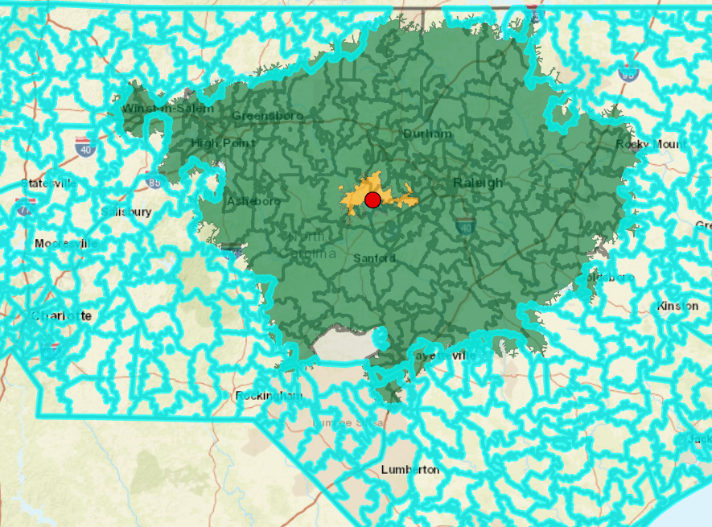
NCDOT Research & Innovation Summit 2020
Public Engagement Using Online Advertising
Target Local Stakeholders | Target Relevant but Nonlocal Stakeholders | Target Stakeholders with Relevant Demographic Profile
We aim to target migratorily affected stakeholders that regularly commute to the projects’ site.
Notes:
Goal 2: Target nonlocal stakeholders that are related to the transportation project site
We aim to target migratorily affected stakeholders that regularly commute to the projects’ site.
The Google Ads targeting option “People in or regularly in your targeted locations”, as its name says, will send advertisements to people that are often in the center (inside the red circle). Instead of showing ads to people only when they are physically located in the targeted location, it will also be possible to send them to people who regularly commute or travel to the targeted locations even when they aren’t physically there. However, if they are not physically in the red circle, they will still have to be inside the bounds of the drive time polygons. If they are outside the outer green ring they are in the excluded regions and there is no way of them receiving the ad no matter how much they travel to the center.

Slide 14
NCDOT Research & Innovation Summit 2020
Public Engagement Using Online Advertising
Target Local Stakeholders | Target Relevant but Nonlocal Stakeholders | Target Stakeholders with Relevant Demographic Profile
We aim to target stakeholders that have a greater interest in the proposed transportation project.
Notes:
The final goal will be to target stakeholders …
In order to meet this goal both the exclusion and demographic tool will be used
Again the outer drive-time polygon will be imported in the exclusion tool but now demographic analysis will be added to further identify stakeholders that have a greater interest in the proposed transportation project and are either centrally or migratorily affected.
As you can see in the graph the red areas are locations that have high concentrations of stakeholders with the specific demographic characteristics we have identified in our literature review.

Slide 15
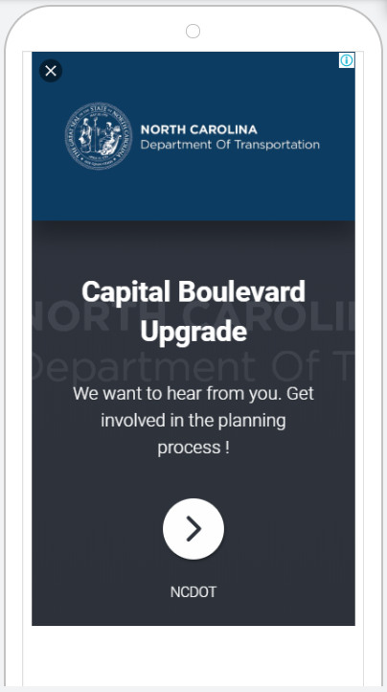

NCDOT Research & Innovation Summit 2020
Semi-Automated Creation of Advertising Campaigns
List with excluded Zip Code, US States and other counties
List with areas that have significant population density of specific demographics
Personalized Spatial Engagement Portal
Notes:
It would be very time consuming to individually run the spatial and geographical tools and utilize their results to structure advertising campaigns for several transportation projects. Consequently, Robotic Process Automation will be used to create targeted advertising in the most efficient way. Robotic Process Automation, RPA stands at the process-driven side of the continuum known as Artificial Intelligence. Along with Robotics and Artificial Intelligence technology, scientists and software developers have also constructed programs whose aim is to automate repetitive tasks.
RPA will call up the corresponding spatial and demographic analysis scripts that will run on ArcGIS Pro. The results of the scripts will be saved locally for future use by the RPA. Then, the automated script will locate the csv files with the outcome of the analysis and use them as input in order to set up the location targeting and achieve our advertising goals.

Slide 16
NCDOT Research & Innovation Summit 2020

Slide 17

NCDOT Research & Innovation Summit 2020
Spatial Public Engagement Portal
DEMO
Notes:
Once the affected and relevant stakeholders have been attracted they will be directed to the personalised Spatial Engagement Portal (SPEP). The SPEP portal will be implemented with ArcGIS Story Maps and Surveys123. Its aim is to provide detailed information and engage the stakeholders with the perceived project outcomes through a user friendly, highly engaging interface [proposal]. Additionally, the attracted stakeholders will be able to provide their feedback on the project and any suggestions that they may have. Finally, they will be asked to complete a quick survey that will help us evaluate our innovative public outreach and engagement approach.

Slide 18
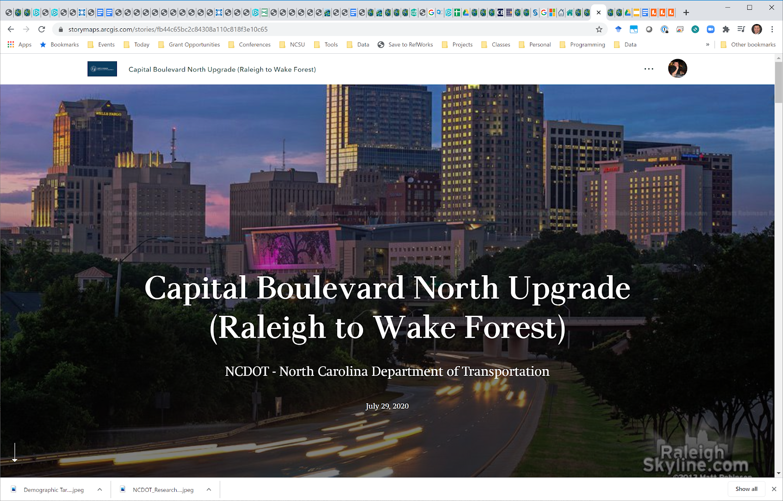
NCDOT Research & Innovation Summit 2020
Spatial Public Engagement Portal
Example Story Map:
https://storymaps.arcgis.com/stories/fb44c65bc2c84308a110c818f3e10c65
George’s summer research presentation video: https://www.youtube.com/watch?v=34KNasYnAio

Slide 19


NCDOT Research & Innovation Summit 2020
Thank you !
Any Questions?
Dr. Okan Pala | opala@ncsu.edu

